Slide 1
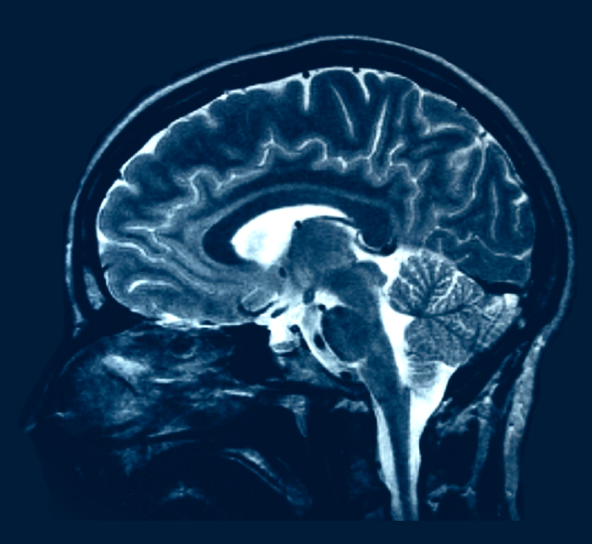
Using Spiking Neural Networks for Pattern Recognition
Nima Mohammadi
Under Supervision of Dr. Ganjtabesh
September 2016

Slide 2
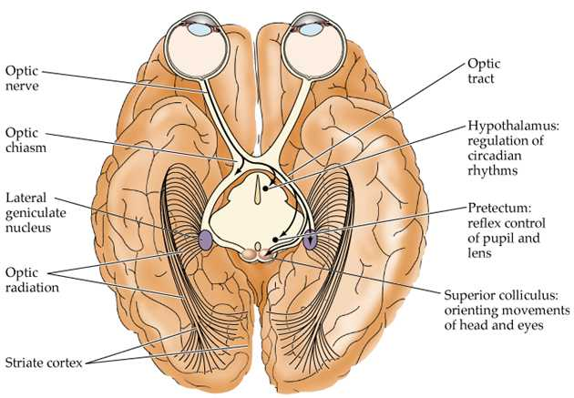
Brain
Retina

Slide 3
Brain
Lateral Geniculate Nucleus and V1
RF
Stimulus
Simple-cell Response
Complex-cell Response
Ganglion Bipolar RF
V1 Orientational RF

Slide 4
Brain
Two-Streams Hypothesis
Ventral stream (what pathway) including V1, V2, V4, IT
Dorsal stream (where pathway) including V1, V2, V3, MT, MST
Dorsal Stream
Ventral Stream

Slide 5
Brain
Neuron

Slide 6
Neural Modeling
Mathematical Modeling
Experience shows that a model should be as simple as possible in order to be tractable (possible to analyze, easy to do computations with) and in order to make strong statements about the physical system being modeled.
“It can scarcely be denied that the supreme goal of all theory is to make the irreducible basic elements as simple and as few as possible without having to surrender the adequate representation of a single datum of experience.”
-Einstein
With increased complexity of model, uncertainty of modeling results increases. Also the explanatory power of model is lost. Of course the degree of simplicity that is achievable is dependent on the scientific question posed.

Slide 7
Large-Scale Modeling
Is a Detailed Model More Realistic?
It seems that a higher level model should be composed of component models at a lower level, and in turn must be much more complex and have more parameters than a model of a neuron. If true, one might ask what is the proper lowest level? After all, the deeper the level, the more realistic, right?!
Wrong! Including more details from lower levels leads to more model parameters which makes it harder to obtain a realistic model since the realism of a model is related to how well-constrained it is by experimental data.
More model parameters means that more data is required to determine them, data which can often contain uncertainties and be hard to acquire.
Example: The propagation of sound through air.

Slide 8
Neural Modeling
Abstraction
Modeler’s wrench, abstraction: taking away aspects not important for answering the scientific questions which the model is designed to address, useful models can be formulated at different levels of organization without loss of tractability.
‌Subsampling is often employed to decrease model size. With fewer pre-synaptic units providing synapses, it becomes necessary to exaggerate connection density or synaptic conductance. This results in a network with unnaturally few and strong signals circulating, in contrast to the real network, where many weak signals interact. Therefore differences might arise such as artificial synchronization which is a problem especially since synchronization is one of the more important phenomena.

Slide 9

Neuronal Networks
Improve understanding of brain functionality involving interactions of billions of neuronal and synaptic processes.
Perform experiments (on a computer) that are impossible (experimentally or ethically) to be done on humans or animals.
Eventually improve and test hypotheses about complex behaviors:
Perception • Attention • Learning • Memory • Consciousness • Sleep and wakefulness

Slide 10
Object Recognition
Computational Approach
DiCarlo, James J., Davide Zoccolan, and Nicole C. Rust. (2012). How does the brain solve visual object recognition? Neuron

Slide 11
Object Recognition
Computational Approach (cont.)

Slide 12
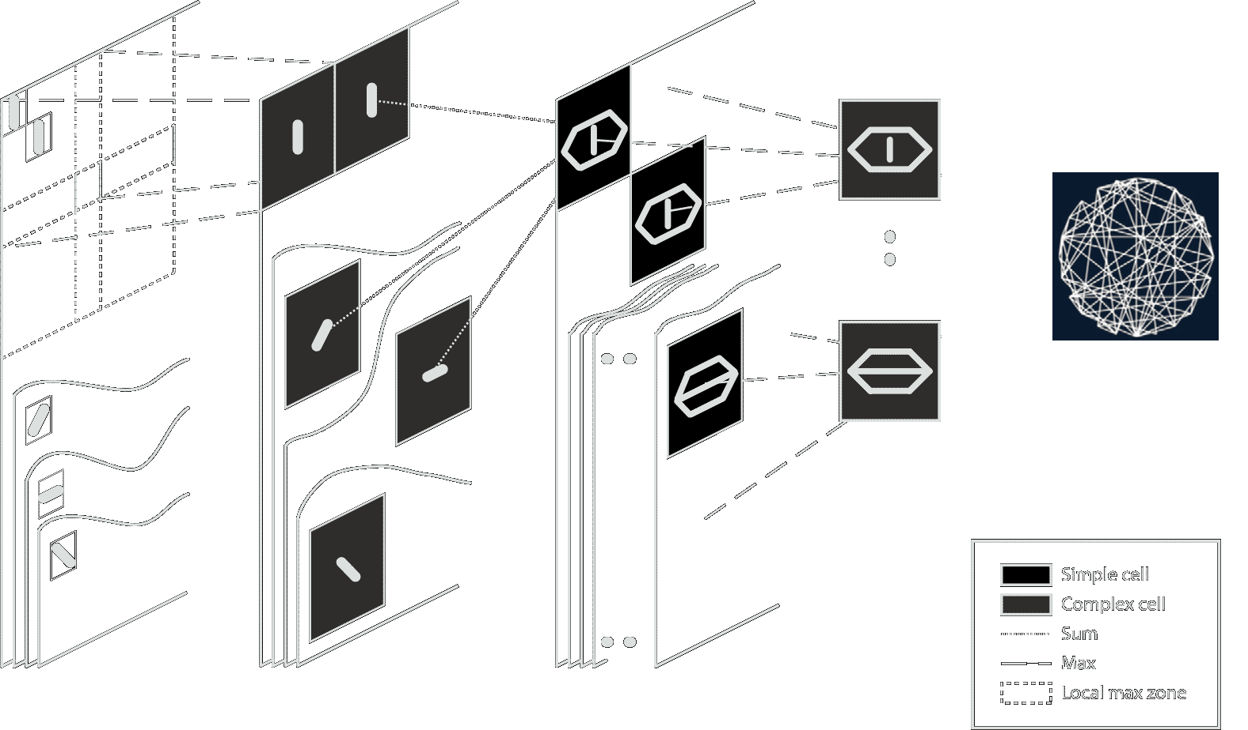
Experiment
Model Schema

Slide 13

Experiment
Dataset
Evaluated the neural network on two Caltech datasets (www.vision.caltech.edu):
Faces 1999
Motor-cycles 2001
All images were rescaled to be 300 pixels in height (preserving the aspect ratio) and converted to gray-scale values.
Class Part #samples
Train
Test
Train
Test
150
285
150
285
Faces
Motorcycle

Slide 14
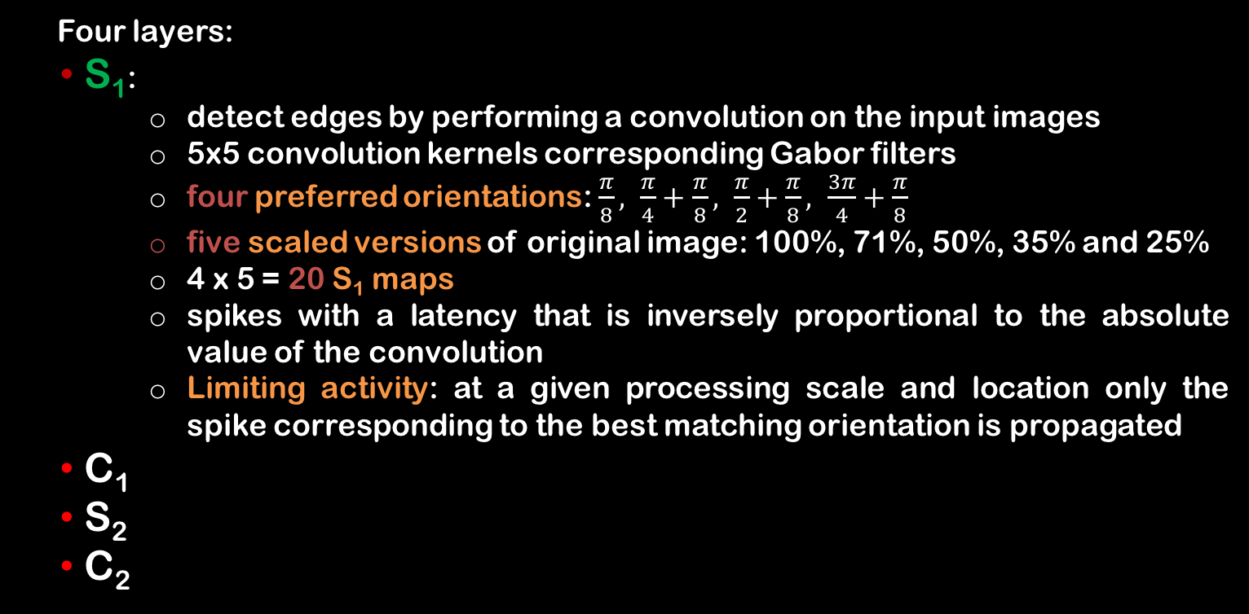
Experiment
Hierarchical Network
S1
Four layers:
‌S₁:
detect edges by performing a convolution on the input images
5x5 convolution kernels corresponding Gabor filters
‌four preferred orientations: $\frac{π}{8}, \frac{π}{4}+\frac{π}{8}, \frac{π}{2}+\frac{π}{8}, \frac{3π}{4}+\frac{π}{8}$
five scaled versions of original image: 100%, 71%, 50%, 35% and 25%
4 x 5 = 20 S₁ maps
spikes with a latency that is inversely proportional to the absolute value of the convolution
‌Limiting activity: at a given processing scale and location only the spike corresponding to the best matching orientation is propagated
‌C₁
‌S₂
‌C₂

Slide 15
Experiment
Hierarchical Network
C1
Four layers:
‌S₁
‌C_{1:}
‌Subsampling S₁ maps (36 times fewer C₁ cells)
‌propagate the first spike emitted by S1 cells in a 7x7 square of a given S1 map (corresponding to one preferred orientation and one processing scale
‌Max operation is a biologically plausible way to gain local shift invariance
Lateral inhibition: Upon emitting a spike, the latency of neighbors within a 11x11 square in the map is increased (latency decreases with distance from the spike)
‌S₂
‌C₂

Slide 16
Experiment
Hierarchical Network
S2
Four layers:
‌S₁
‌C₁
‌S_{2:}
intermediate complexity visual features
Each prototype cell is duplicated in 5 maps (weight sharing), each map corresponding to one processing scale
Within those maps the S2 cells can only integrate spikes from the four C1 maps of the corresponding processing scale
RF size is 16 x 16 C1 cells
C1-S2 synaptic connections are set by STDP
No leakage in neuron model
kWTA ensures that at most two cells can fire for each processing scale (only during learning phase). Without it there would be a bias toward small patterns (large scales)
‌C₂

Slide 17
Experiment
Hierarchical Network
C2
Four layers:
‌S₁
‌C₁
‌S₂
‌C_{2:}
take the maximum response (i.e. first spike) for each prototype S2 cells over all positions and processing scales
shift and scale invariant cells

Slide 18
Experiment
Hierarchical Network
Neural and Synaptic Model
Integrate and Fire (IF) neural model is used as building blocks for the hierarchical network
No Leakage needed!
Synapses are current based (CUBA)
A simplified STDP is used for learning.
For our task we have restricted the feature to only four!
The hierarchical network is tested across various parameters:
Parameter | Values
SRF | 15, 17
Threshold | 100, 80, 65, 30, 10
Epochs | 20, 10, 5
Masquelier and Thorpe (2007). Unsupervised learning of visual features through spike timing dependent plasticity. PLoS Comput Biol

Slide 19

Experiment
Hierarchical Network
STDP Model
A simplified STDP rule:
$$∆w_{ij}= \left\{\begin{aligned}a^{+}.w_{ij}.\left(1−w_{ij}\right) \text{if} t_{j}−t_{i}≤0 (LTP) \\ a^{−}.w_{ij}.\left(1−w_{ij}\right) \text{if} t_{j}−t_{i}>0 (LTD)\end{aligned}\right.$$
With this rule only the order of the spikes matters, not their precise timings
As a result the intensity-latency conversion function of S1 cells has no impact, any monotonously decreasing function give the same results
a⁺ and |a⁻| are increased during simulation as STDP learning progresses (multiplying by 2 every 400 postsynaptic spikes)

Slide 20
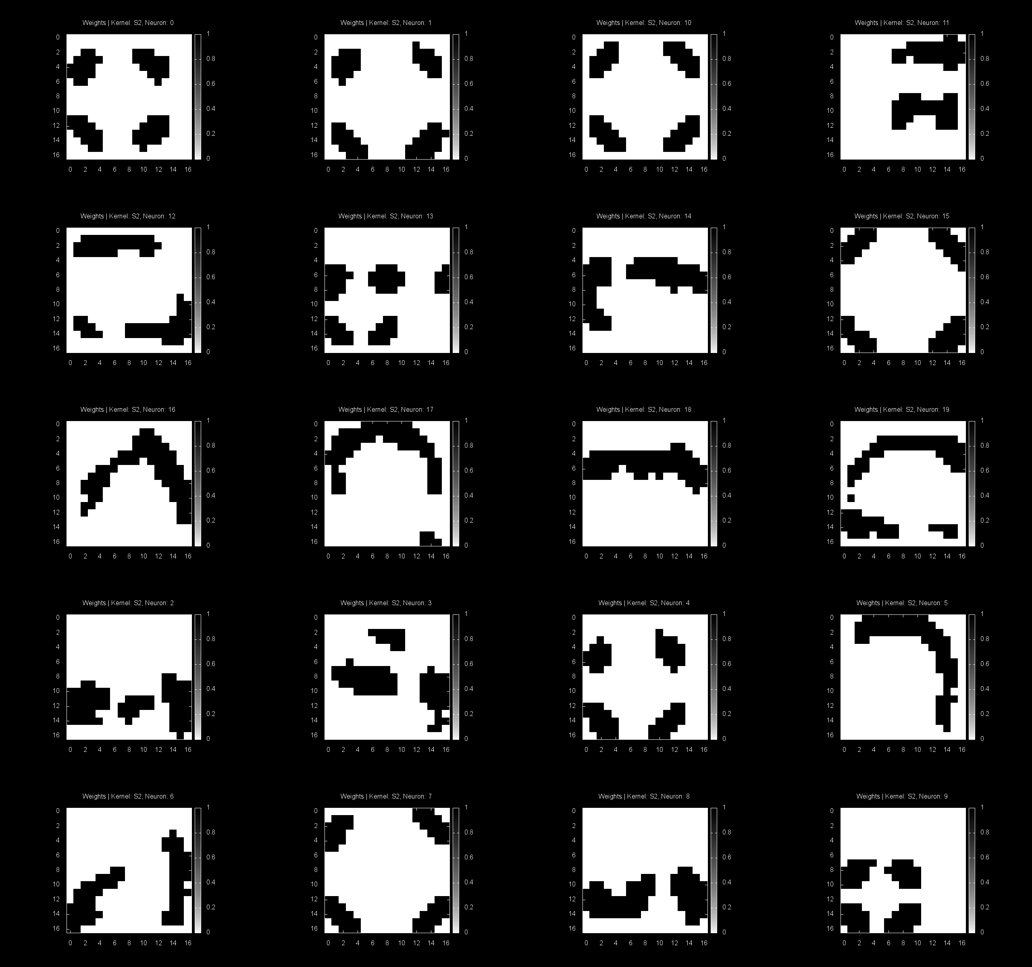
Experiment
Hierarchical Network
Features

Slide 21
Experiment
Model Schema

Slide 22
Reservoir Computing
Basic Paradigm
Also known as Echo State Networks and Liquid State Machines
Discovered in 2000, now an established paradigm in computational neuroscience and machine learning
RC makes, for the first time, training of recurrent neural networks practically feasible: a major enabling technology
RC is biologically plausible
Principles of RC
Use large, fixed, random recurrent network as excitable medium
Excite by input signal
Read out desired output

Slide 23
Reservoir Computing
Liquid State Machine
Recurrent structures without the training: Reservoir Computing
Jaeger (2001): Echo State Networks (engineering)
Maass (2002): Liquid State Machines (neuroscience)
Steil (2003): weight dynamics of Atiya-Parlos equivalent
Fixed, random topology operated in correct dynamic regime
Different node types possible: THG, linear, tanh, spiking, …
Linear “readout” function which is trained (No local minima, no problems with recurrent structure, one shot learning)
On-line computing: prediction at every time-step
Any time-invariant filter with fading memory can be learned (with output feedback, universal computing)

Slide 24

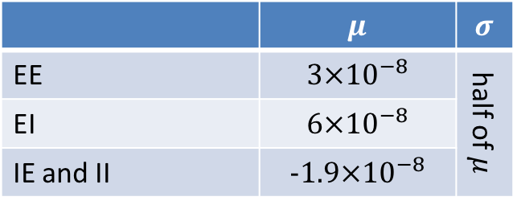
Liquid State Machine
Neuronal and Synaptic Models
Leaky Integrate and Fire model is used for this network.
$$τ_{m}\frac{dV_{m}}{dt}=−\left(V_{m}−v_{rest}\right)+ R_{m}(I_{syn}+I_{inject}+I_{noise})$$
The refractory period for Exc and Inh neurons is set to 3ms and 2ms, respectively.
Dynamic synapses (short-term plasticity) are connecting neurons to each other.
Synaptic weights are static and initialized to ${W×W}_{scale}$, where $W$ is randomly drawn from a Normal distribution as below:
 | $$μ$$ | $$σ$$
EE | $$3×{10}^{−8}$$ | half of $μ$
EI | $$6×{10}^{−8}$$
IE and II | $$−1.9×{10}^{−8}$$
Maas et al. (2002). Real-time computing without stable states: A new framework for neural... Neural computation

Slide 25
Connection Topology
Mass’s
The original connection technique proposed by Maas for Liquid State Machines:
$$p=C.exp⁡[−{(\frac{D(a,b)}{λ})}^{2}]$$
Where
D(a, b) is the Euclidean distance between neurons a and b,
𝞴 is a connection parameter
and C is set depending on whether neurons are inhibitory (I) or excitatory (E):
0.3 (EE)
0.2 (EI)
0.4 (IE)
0.1 (II)

Slide 26
Connection Topology
Mass’s
$$λ=0.5$$

Slide 27
Connection Topology
Mass’s
$$λ=1.0$$

Slide 28
Connection Topology
Mass’s
$$λ=1.5$$

Slide 29
Connection Topology
Small-World
Lattice A
Lattice B
Watts–Strogatz Algorithm:
The network is created by removing each edge with uniform, independent probability p and rewiring it to yield an edge between a pair of nodes that are chosen uniformly at random.

Slide 30
Connection Topology
Small-World (A)
Type A, $P=0$

Slide 31
Connection Topology
Small-World (A)
Type A, $P=0.05$

Slide 32
Connection Topology
Small-World (A)
Type A, $P=0.1$

Slide 33
Connection Topology
Small-World (B)
Type B, $P=0$

Slide 34
Connection Topology
Small-World (B)
Type B, $P=0.05$

Slide 35
Connection Topology
Small-World (B)
Type B, $P=0.1$

Slide 36
Connection Topology
Erdős–Rényi
An extreme case of small-world networks where P=1 is called Erdős–Rényi (fully random)
Type A, $P=1$
Type B, $P=1$

Slide 37
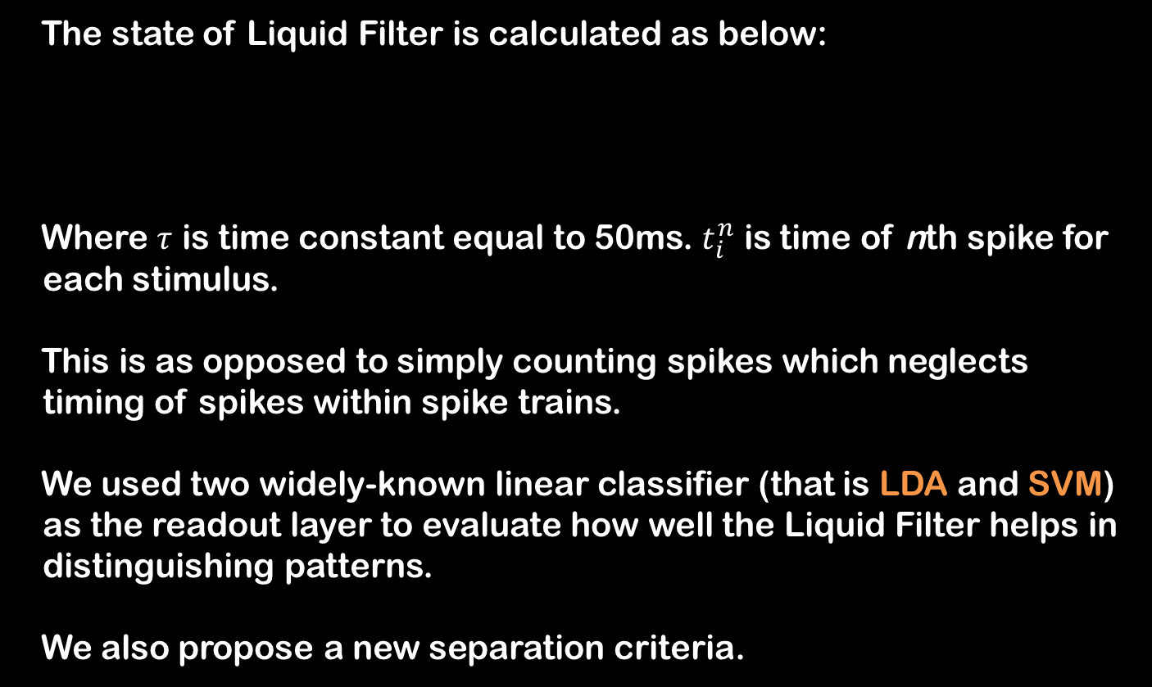

Readout Layer
Liquid State
The state of Liquid Filter is calculated as below:
Where $τ$ is time constant equal to 50ms. $t_{i}^{n}$ is time of nth spike for each stimulus.
This is as opposed to simply counting spikes which neglects timing of spikes within spike trains.
We used two widely-known linear classifier (that is LDA and SVM) as the readout layer to evaluate how well the Liquid Filter helps in distinguishing patterns.
We also propose a new separation criteria.
$$s_{m}^{f}\left(i\right)= \sum_{n}{exp⁡(−\frac{t_{i}^{n}}{τ})}$$

Slide 38



Readout Layer
Separation Measure
Using LDA and SVM has the drawback of performance dependence on an ML technique which is not inherent to reservoir computing scheme. It is also time consuming to use an actual classifier.
The classic way to assess separation capability of network is to use Fisher Discriminant Ratio:
Trace of $S_{m}$ calculates the variance of features across global mean while trace of $S_{w}$ is sum of features variances for all classes
$$S_{b}= \sum_{i=1}^{M}{P_{i}(μ_{i}−μ_{0}){(μ_{i}−μ_{0})}^{T}}$$
$$S_{w}=\sum_{i=1}^{M}{P_{i}Σ_{i}}$$
$$S_{m}= S_{w}+S_{b}$$
$$FDR=trace(S_{w}^{−1}S_{m})$$

Slide 39


Readout Layer
Separation Measure (cont.)
However we have not used FDR. As Liquid State may be comprised of collinear features, $S_{w}$ might be a singular matrix, and therefore its inverse can not be calculated.
We may overcome this by adding a negligible number to main diagonal or use pseudo-inverse technique, both of which fail to fully depict the separation capability.
Other separation measure use Euclidean or Bray-Curtis distance. Based on previous works, we propose the following:
$$D_{b}= \frac{\sum_{i=1}^{M}{\sum_{j=1}^{M}{{\left\|μ_{i}−μ_{j}\right\|}_{2}}}}{M^{2}}$$
$$D_{w}= \sum_{i=1}^{M}{\sum_{j=1}^{N}{σ_{i,j}}}$$
$$Separation= \frac{D_{b}}{D_{w}+1}$$

Slide 40
Results
Active Neurons
The plots are obtained by interpolation of a number of points (black dots) whose performance are calculated for the corresponding parameters.

Slide 41
Results
Separation
For each set of parameters the network has been evaluated six times.

Slide 42
Results
LDA

Slide 43
Results
SVM

Slide 44
Results
Classification Accuracy
Connection Topology | Separation | LDA | SVM
Maas | 1.34 | 92.5 | 91.8
SW-A | 1.41 | 92.6 | 92
SW-B | 1.36 | 92.4 | 91.6

Slide 45
Future Works
‌Incorporating multiple readouts and partitioning liquid state to overlapping or non-overlapping smaller snapshots.
‌There are plenty more topologies to consider (scale-free, etc.). There are also technique to mimic non-spherical directional axonal growth of synapses.
‌LSMs generally do not incorporate synaptic plasticity. We may still investigate the possibility of evolutionary finding the best connection topology by dynamically adding/removing synapses during simulation.
‌No work done on motion pictures! LSMs may be applicable for motion-related tasks (dorsal stream) as they are appropriate for time-series.
‌More intricate neuron models (e.g. Hodgkin-Huxley or Izhikevich) may be investigated for more biologically plausible models. Polychronization is also interesting!

Slide 46
Selected References
Kaiser, Marcus, Hilgetag, Claus C, and Van Ooyen, Arjen. A simple rule for axon outgrowth and synaptic competition generates realistic connection lengths and filling fractions. Cerebral Cortex, 19(12):3001–3010, 2009.
Hourdakis, Emmanouil and Trahanias, Panos. Improving the classification perfor- mance of liquid state machines based on the separation property. in Engineering Applications of Neural Networks, pp. 52–62. Springer, 2011.
Wojcik, Grzegorz M and Ważny, Marcin. Bray-curtis metrics as measure of liquid state machine separation ability in function of connections density. Procedia Computer Science, 51:2979–2983, 2015.
Masquelier, Timothée, and Simon J. Thorpe. "Unsupervised learning of visual features through spike timing dependent plasticity." PLoS Comput Biol 3.2 (2007): e31.
Maass, Wolfgang, Thomas Natschläger, and Henry Markram. "Real-time computing without stable states: A new framework for neural computation based on perturbations." Neural computation 14.11 (2002): 2531-2560.
Ju, Han, et al. "Effects of synaptic connectivity on liquid state machine performance." Neural Networks 38 (2013): 39-51.
Hourdakis, Emmanouil, and Panos Trahanias. "Improving the classification performance of Liquid State Machines based on the separation property." Engineering Applications of Neural Networks. Springer Berlin Heidelberg, 2011. 52-62.

Slide 47
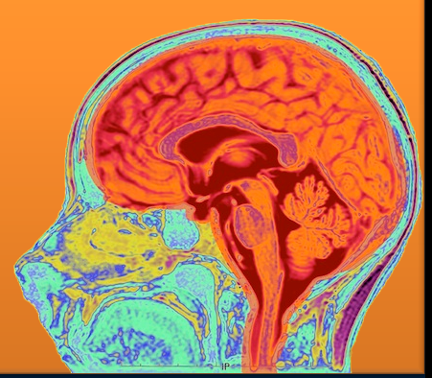
Thanks for your attention :)
Any Questions?!

Slide 48
Neural Modeling
‌Principle of hierarchical reductionism: study smaller and smaller parts and attempt to understand the whole .
While it remains uncertain whether a brain system can be understood as the interaction between independently describable subsystems, the brain does display a hierarchy of spatial scales with repeated structure such as molecules, synapses, neurons, microcircuits, networks, regions and systems.
How the advent of modeling in computational neuroscience opens the possibility to study the dynamics of models simultaneously incorporating various levels from molecules to regions?

